Slide 1
Ultimate Business Loan Spreadsheets Infographics
Here is where this template begins

Slide 2
Ultimate business loan spreadsheets infographics
Num | Date | Loan | Scheduled | Principal | Cumulative | Interest | Balance
01 | 3/6/22 | $120,000 | $530 | $213 | $313 | $167 | $88,797
02 | 3/7/22 | $88,797 | $230 | $233 | $546 | $166 | $849,594
03 | 3/8/22 | $110,594 | $250 | $194 | $230 | $166 | $97,390
04 | 3/9/22 | $123,390 | $650 | $324 | $874 | $166 | $95,186
05 | 3/10/22 | $87,186 | $360 | $434 | $1,018 | $165 | $91,982

Slide 3
Ultimate business loan spreadsheets infographics
Lender name | Mercury | Scheduled payment | $440
Loan amount | $340,000 | Number of payments | 320
Interest rate | 5.00% | Total interest | $26,500
Loan term in years | 30 | Pay off date | 5/6/2045
Loan repayment start | 5/11/2022 | Total payment | $155,500

Slide 4
Ultimate business loan spreadsheets infographics
Total early payments | $49,583
Actual number of payments | 16
Actual pay off date | October 20
Years saved | 5
Total interest | +24%
Total payment | $113,563
Total savings | $21,584

Slide 5
Ultimate business loan spreadsheets infographics
Company car loan
Values |  | Summary
Vehicle value | $250,000 | Initial deposit | $0
% Deposit | 0% | Amount financed | $140,500
Loan term (in months) | 24 | Net loan amount | $140,500
Annual interest rate | 12% | Monthly loan amount | $3,825
Repayment frequency | Monthly | Monthly fee | $190
Annual loan fee | $230 | Total monthly payment | $4,030

Slide 6
Ultimate business loan spreadsheets infographics
Loan payment schedule
# | Outstanding loan | Principal paid | Interest paid | Loan repayment | Loan fee
01 | $76,238 | $4,782 | $734 | $3,615 | $19
02 | $72,425 | $4,813 | $802 | $2,615 | $18
03 | $68,579 | $3,945 | $740 | $3,815 | $20
04 | $64,702 | $3,887 | $638 | $4,715 | $21
05 | $60,793 | $3,910 | $706 | $6,615 | $17

Slide 7
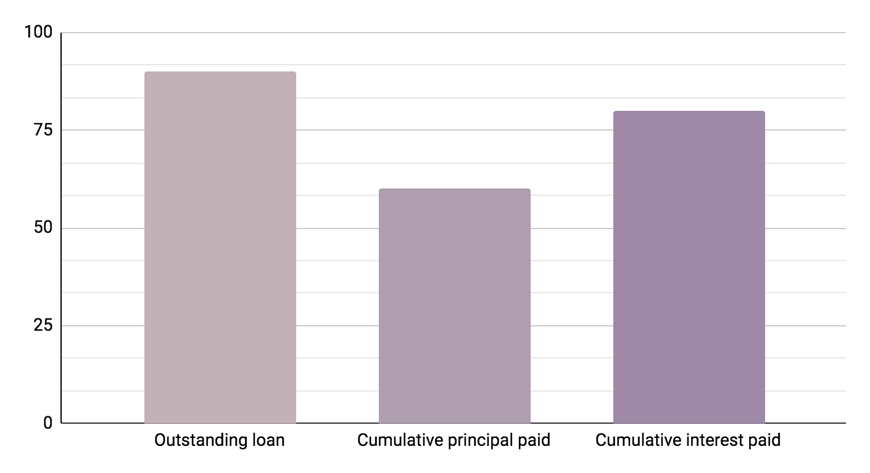
Ultimate business loan spreadsheets infographics
01
Outstanding loan
Mercury is the closest planet to the Sun
02
Cumulative principal paid
Venus is the second planet from the Sun
03
Cumulative interest paid
Despite being red, Mars is a cold place
90%
60%
80%
Follow the link in the graph to modify its data and then paste the new one here. For more info, click here

Slide 8
Ultimate business loan spreadsheets infographics
Commercial loan
Loan amount | $100,000 | Monthly payment | $4,387
Annual interest rate | 5.00% | Balloon payment | $55,634
Amortization period | 24 months | Total payments | 4
Payments per year | 12 | Total interest paid | 1.00%
Begin date | 6/3/22 | Interest only | $12,321
Refinance residual balloon payment? |  |  | Yes

Slide 9
Ultimate business loan spreadsheets infographics
Refinance | New loan | Current loan | Delta
Loan amount | $100,000 | $100,000 | $0
Interest rate | 8.00% | 10.00% | -2.00%
Term in years | 2 | 2 | 0.0
Extra payment | 0 | 0 | $0
Closing cost | N/A | $1,000 | N/A
Monthly payment | $4,523 | $4,614 | -$92

Slide 10
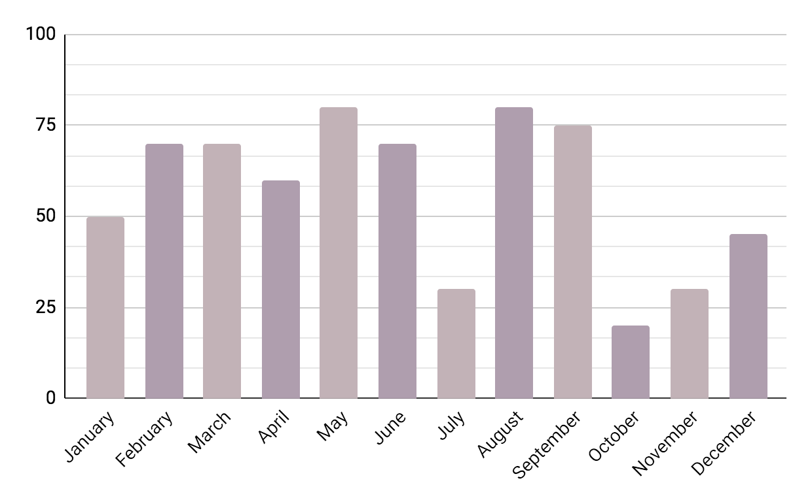
Ultimate business loan spreadsheets infographics
Company car loan
Vehicle value | $250,000
% Deposit | 0%
Loan term | 24
Interest rate | 12%
Frequency | Monthly
Annual fee | $230
Follow the link in the graph to modify its data and then paste the new one here. For more info, click here

Slide 11
Ultimate business loan spreadsheets infographics
 | New loan | Current loan | Delta
Total interest | $40,000 | $20,000 | $0
Total payment | $140,000 | $120,000 | $0
Breakeven period | 2 years | Months | 24
 | New loan | Current loan | Delta
Total interest | $30,000 | $10,000 | $0

Slide 12
Ultimate business loan spreadsheets infographics
Commercial loan
Refinanced balloon residual | $160,000
Loan amount | $40,000
Interest rate | 10.00%
Term in years | 4
Monthly Payment | $4,614

Slide 13
Ultimate business loan spreadsheets infographics
01
02
03
04
Outstanding loan
Balloon payment
Principal paid
Interest paid
Mercury is the closest planet to the Sun
Despite being red, Mars is a cold place
Jupiter is the biggest planet of them all
Saturn is a gas giant and has rings

Slide 14
Ultimate business loan spreadsheets infographics
Payment schedule: current loan (CL)
Month | CL outstanding loan | Paid | Interest | Balance | CL accumulated principal | CL accumulated interest
1 | $100,000 | $4,614 | $833 | $96,219 | $3,781 | $833
2 | $96,219 | $4,614 | $802 | $92,406 | $7,594 | $1,635
3 | $92,406 | $4,614 | $770 | $88,562 | $11,438 | $2,405
4 | $88,562 | $4,614 | $738 | $84,685 | $15,315 | $3,143
5 | $84,685 | $4,614 | $706 | $80,776 | $19,224 | $3,849

Slide 15
Ultimate business loan spreadsheets infographics
Business loan values |  | Business loan summary
Loan amount | $100,000 | Total loan amount | $100,020
Loan term | 24 months | Monthly loan amount | $4,255
Annual interest rate | 2% | Monthly fee | $17
Annual loan fee | $200 | Monthly payment | $4,272
Other one-off fee(s) | $20

Slide 16
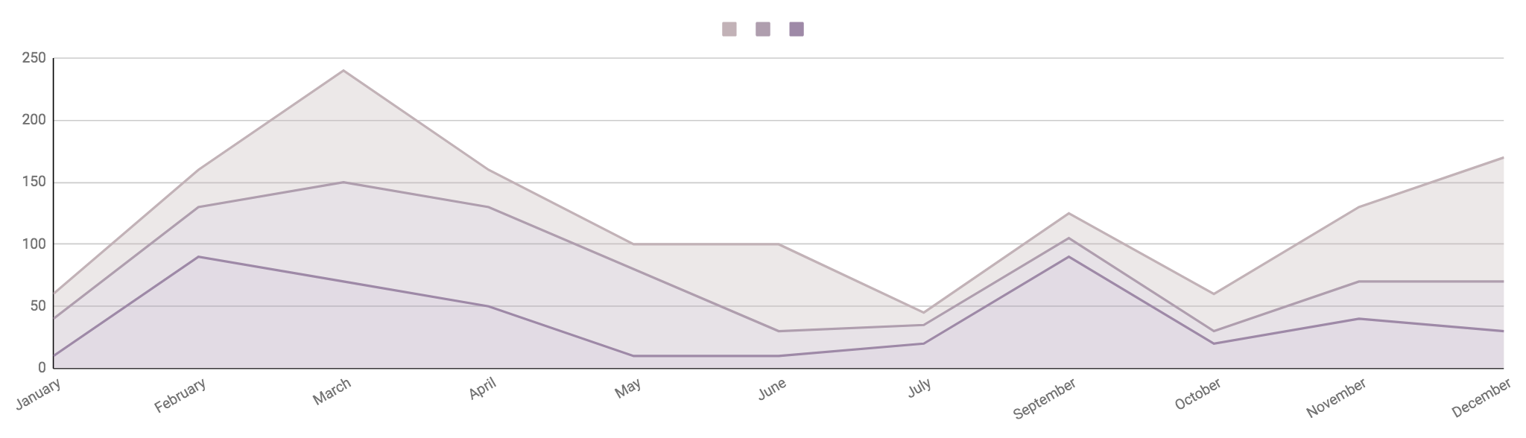
Ultimate business loan spreadsheets infographics
Accumulated interest
Principal paid
Outstanding loan
Mercury is the closest planet to the Sun
Despite being red, Mars is a cold place
Saturn is a gas giant and has several rings
$250,000
$150,000
$100,000
Follow the link in the graph to modify its data and then paste the new one here. For more info, click here

Slide 17
Ultimate business loan spreadsheets infographics
Starting debt
$50,000
Payment |  | Payment frequency
$500 |  | Monthly
Interest rate |  | Compounding
2.00% |  | Annual

Slide 18
Ultimate business loan spreadsheets infographics
Month | Payment | Remaining debt | Time to pay off
Mar 2022 | $500 | $49,583 | 9 years 1 month
Apr 2022 | $500 | $49,166 | 9 years
May 2022 | $500 | $48,748 | 8 years 11 months
Jun 2022 | $500 | $48,329 | 8 years 10 months
Jul 2022 | $500 | $47,910 | 8 years 9 months
Aug 2022 | $500 | $47,490 | 8 years 8 months

Slide 19
Ultimate business loan spreadsheets infographics
Loan amount
01
02
Interest rate
Saturn is a gas giant and has several rings
Neptune is the farthest planet from the Sun
Total payments
04
03
Amortization period
Mercury is the closest planet to the Sun
Despite being red, Mars is a cold place

Slide 20
Ultimate business loan spreadsheets infographics
Paid | Interest | Principal | Final balance
$3,632 | $833 | $3,781 | $96,219
$4,614 | $802 | $3,813 | $92,406
$3,434 | $770 | $3,844 | $88,562
$4,142 | $738 | $3,876 | $84,685
$4,223 | $706 | $3,909 | $80,776
$3,572 | $673 | $3,941 | $76,835

Slide 21
Ultimate business loan spreadsheets infographics
Principal amount | $450,000 |  | Term | 2 years
Interest rate | +0.2% |  | Start date | January 2024
Schedule
Period | Date | Monthly | Interest | Principal | Balance
January | 01/20 | $455 | $30 | $1,355 | 21%
February | 02/18 | $420 | $32 | $1,940 | 21%
March | 03/21 | $399 | $34 | $2,150 | 21%
April | 04/20 | $440 | $36 | $2,300 | 21%

Slide 22
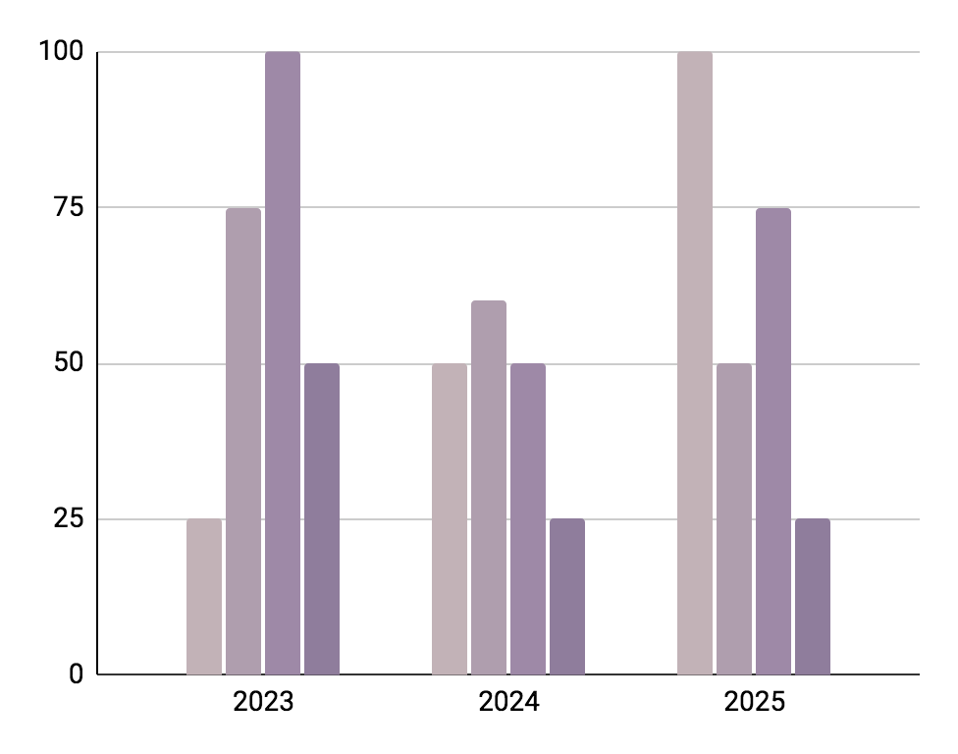
Ultimate business loan spreadsheets infographics
New loan
Current loan
Saturn is a gas giant and has rings
Neptune is far away from Earth
Delta
Interest rate
Mercury is the smallest planet
Despite being red, Mars is a cold place
Follow the link in the graph to modify its data and then paste the new one here. For more info, click here

Slide 23
Ultimate business loan spreadsheets infographics
Repayment period (years)
Interest rate | 3 | 4 | 5 | 6 | 7 | 8
4.00% | $1,180.96 | $903.16 | $736.66 | $625.81 | $546.75 | $487.57
4.50% | $1,189.88 | $912.14 | $745.72 | $634.96 | $556.01 | $496.93
5.00% | $1,198.84 | $921.17 | $754.85 | $644.20 | $565.36 | $506.40
5.50% | $1,207.84 | $930.26 | $764.05 | $653.52 | $574.80 | $515.97
6.00% | $1,216.88 | $939.40 | $773.31 | $662.92 | $584.34 | $525.66
6.50% | $1,225.96 | $948.60 | $782.65 | $672.40 | $593.98 | $535.45

Slide 24
Ultimate business loan spreadsheets infographics
Loan refinance comparison
 | New loan | Current loan | Delta
Loan amount | $100,000 | $100,000 | $0
Interest rate | 8.00% | 10.00% | -2.00%
Term in years | 2 | 2 | 0.0
Monthly payment | 0 | 0 | $0
Closing cost | N/A | $1,000 | N/A
Monthly payment | $4,523 | $4,614 | -$92

Slide 25
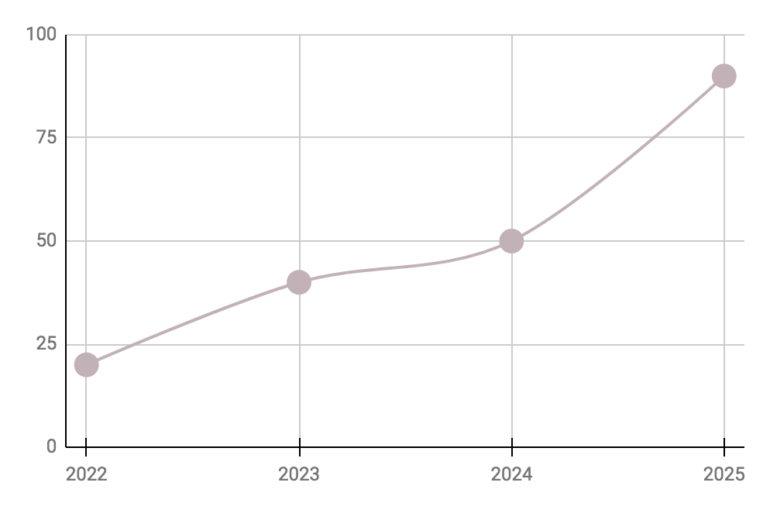
Ultimate business loan spreadsheets infographics
Interest rate
2022
20%
Neptune is the farthest planet from the Sun
2023
40%
Despite being red, Mars is a cold place
2024
50%
Pluto is considered a dwarf planet
2025
90%
Ceres is located in the main asteroid belt
Follow the link in the graph to modify its data and then paste the new one here. For more info, click here

Slide 26
Ultimate business loan spreadsheets infographics
Business loan | Month | Mar 2022 | Apr 2022 | May 2022
 | Payment | $500 | $700 | $300
 | Rem. debt | $49,583 | $49,166 | $48,748
 | Time to pay off | 9 years 1 month | 9 years | 8 years 11 months

Slide 27
Ultimate business loan spreadsheets infographics
2023 | Jan | Feb | Mar | Apr | May | Jun | Jul | Aug | Sep | Oct | Nov | Dec
Pluto
Ceres
Neptune
Ceres is located in the main asteroid belt
Pluto is considered a dwarf planet
Saturn is composed of hydrogen and helium
+ 25%
+ 45%
+ 50%
Paid
Interest
Balance
Venus is the second planet from the Sun
Mercury is the closest planet to the Sun
Jupiter is the biggest planet of them all

Slide 28
Ultimate business loan spreadsheets infographics
+30%
01
Interest
Saturn is a gas giant and has several rings
+20%
02
Amortization
Mercury is the closest planet to the Sun
+10%
03
Loan
Venus is the second planet from the Sun

Slide 29
Ultimate business loan spreadsheets infographics
Loan payment schedule by month
January | $4,500 | July | $4,700
February | $3,800 | August | $3,800
March | $4,200 | September | $5,300
April | $2,100 | October | $2,800
May | $5,700 | November | $4,500
June | $4,500 | December | $3,800

Slide 30
Ultimate business loan spreadsheets infographics
January
March
May
$236,000
$453,000
$321,567
Jupiter is the biggest planet of them all
Venus is the second planet from the Sun
Neptune is the farthest planet from the Sun
July
September
November
$567,000
$342,500
$854,980
Mercury is the closest planet to the Sun
Pluto is considered a dwarf planet
Despite being red, Mars is a cold place
Jan | Feb | Mar | Apr | May | Jun | Jul | Aug | Sep | Oct | Nov | Dec

Slide 31
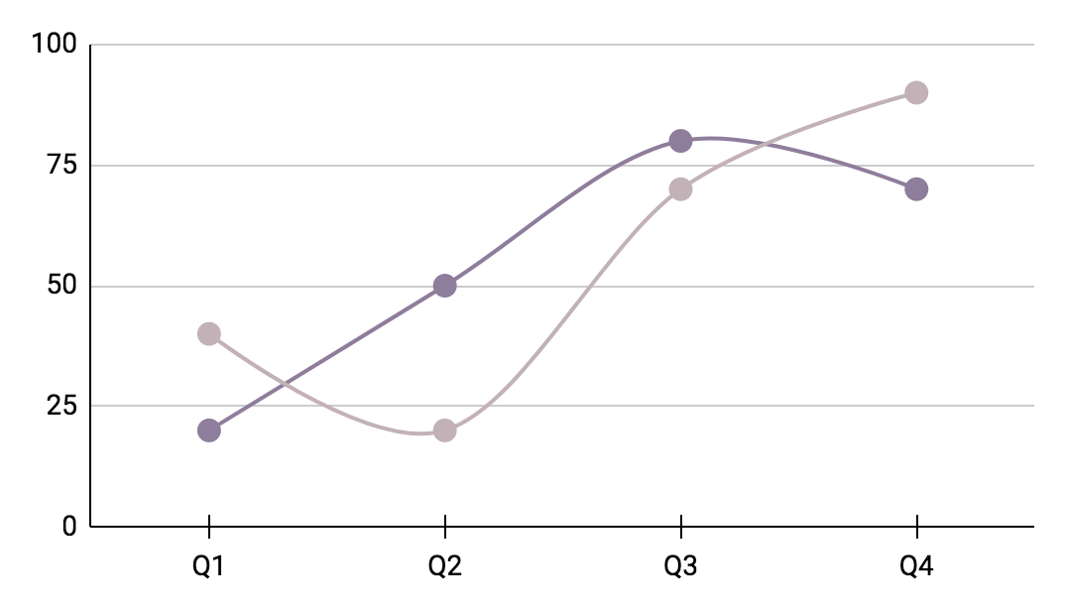
Ultimate business loan spreadsheets infographics
+ 25%
Interest loan rate
Mercury is the closest planet to the Sun
+ 50%
Interest loan fee
Jupiter is the biggest planet of them all
Follow the link in the graph to modify its data and then paste the new one here. For more info, click here

Slide 32
Ultimate business loan spreadsheets infographics
Loan payment monthly schedule
12th | Despite being red, Mars is cold | $130
14th | Venus has a beautiful name | $95
17th | Jupiter is the biggest planet | $15
29th | Saturn is a gas giant with rings | $5
Total paid
$245.00
Month
Mon | Tue | Wed | Thu | Fri | Sat | Sun
 |  |  |  |  | 01 | 02
03 | 04 | 05 | 06 | 07 | 08 | 09
10 | 11 | 12 | 13 | 14 | 15 | 16
17 | 18 | 19 | 20 | 21 | 22 | 23
24 | 25 | 26 | 27 | 28 | 29 | 30
31

Slide 33
Instructions for use (premium users)
As a Premium user, you can use this template without attributing Slidesgo.
You are allowed to:
Modify this template.
Use it for both personal and commercial purposes.
Hide or delete the “Thanks” slide and the mention to Slidesgo in the credits.
Share this template in an editable format with people who are not part of your team.
You are not allowed to:
Sublicense, sell or rent this Slidesgo Template (or a modified version of this Slidesgo Template).
Distribute this Slidesgo Template (or a modified version of this Slidesgo Template) or include it in a database or in any other product or service that offers downloadable images, icons or presentations that may be subject to distribution or resale.
Use any of the elements that are part of this Slidesgo Template in an isolated and separated way from this Template.
Register any of the elements that are part of this template as a trademark or logo, or register it as a work in an intellectual property registry or similar.
For more information about editing slides, please read our FAQs or visit Slidesgo School:
https://slidesgo.com/faqs and https://slidesgo.com/slidesgo-school

Slide 34
Infographics
You can add and edit some infographics to your presentation to present your data in a visual way.
Choose your favourite infographic and insert it in your presentation using Ctrl C + Ctrl V or Cmd C + Cmd V in Mac.
Select one of the parts and ungroup it by right-clicking and choosing “Ungroup”.
Change the color by clicking on the paint bucket.
Then resize the element by clicking and dragging one of the square-shaped points of its bounding box (the cursor should look like a double-headed arrow). Remember to hold Shift while dragging to keep the proportions.
Group the elements again by selecting them, right-clicking and choosing “Group”.
Repeat the steps above with the other parts and when you’re done editing, copy the end result and paste it into your presentation.
Remember to choose the “Keep source formatting” option so that it keeps the design. For more info, please visit Slidesgo School.

